Slide 1
ELEC2814 Engineering Management and Society Management, Power, Authority and Empowerment
Dr. Wilton Fok
wtfok@eee.hku.hk

Slide 2
What’s management?
Process of planning, organizing, directing and controlling an organization’s resources to achieve its goals.
MANAGEMENT is the process of guiding the development, maintenance, and allocation of resources to attain organizational goals.
Management is dynamic in nature and evolves to meet needs and constraints in the organization’s internal and external atmospheres.

Slide 3
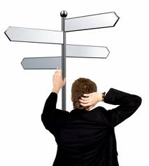

Management Process
Planning
determines what an organization needs to do and how best to get it done
Organizing
determines how best to arrange an organization’s resources and activities into a coherent structure
Directing
involves guiding and motivating employees to meet an organization’s objectives
Controlling
monitors an organization’s performance to make sure that the firm is meeting its goals

Slide 4
Management Process
Management Process has 4 key functional components:
Planning
Organizing
Directing
Controlling
Unplanned
situation
Ad-hoc
events
External
factors
Planning
Organizing
Directing
Output/
Results
Controlling

Slide 5
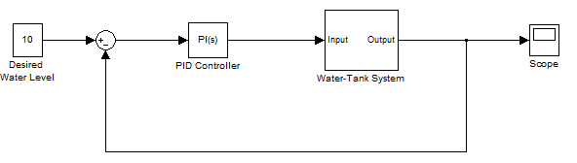
Management Process
Noise (Disturbance)
Organizing
Planning
Directing
Controlling

Slide 6
Without monitoring, directing, and control
RESULTANT O

Slide 7
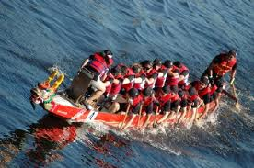
With proper monitoring, directing and controlling

Slide 8
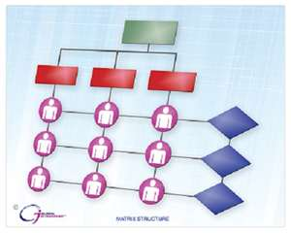
Who takes the control and direct?
In an origination structure, who takes the control and direct the organization? Who manage the company?
What is/are essential element(s) to enable the manager to accomplish the duties?

Slide 9
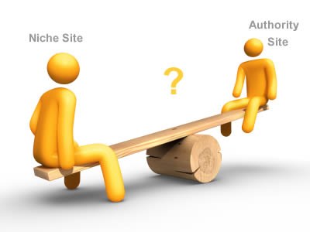
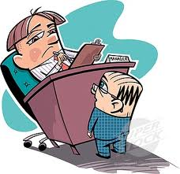
In an organization
What make us different from one another?
Why someone is superior than other?

Slide 10
Power and authority
The Leader which you recommend must have POWER.
And in order that he can make ultimate decision, he must acquire or be given AUTHORITY.

Slide 11
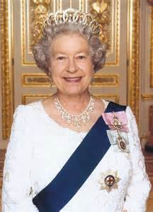
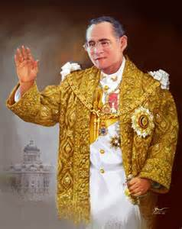
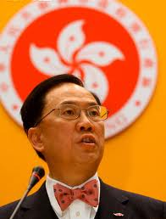
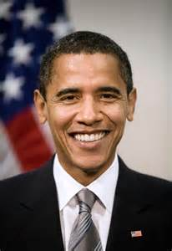
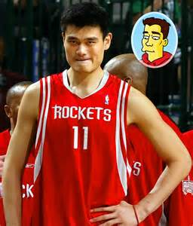

Power and Authority
Power is the ability to handle a specific situation or task. Power can be:
culturally accepted
Systematically installed
personally gifted
self-acquired

Slide 12
Power and Authority
Authority is the right to command human resources and commit other organization’s resources to meet goals.
A leader is one who has authority (legitimate power).
A good leader is one who knows how to empower others so that they shall utilize the best of their power for the leader.
Empowerment
Power
Authorized to command resources

Slide 13


Difference between Power and Authority
Power and Authority look alike, but indeed they are different, because:
Authority can be delegated; power cannot.
A superman has power, but not necessarily authority.
A fool may have authority, but not necessarily all kinds of power necessarily for exercising such authority.

Slide 14
Types of Power
Coercive power
Legitimate power
Expert power
Award (reward) power
Referent power

Slide 15
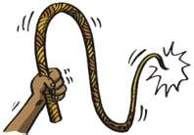
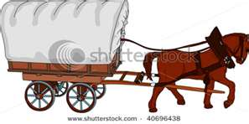
Coercive power
Punishment, the opposite of reward power.
power holder removes something from a person or to punish them for not conforming with a request.

Slide 16
Coercive Power
E.g.
the threat of preventing promotion of a subordinate for poor performance
threat of non-payment;
threat of physical injury.
An element in common - the element of fear.
The fear that these threats will be used is called coercive power.

Slide 17
Legitimate power
Legitimate power is the set of rights which a leader inherits as a result of his position in a power structure.
The authority exercised due to the position in an organization.
I.e. the greater rights and responsibilities he has, compared to others.
Legitimate power can be a relative
Your boss has power above you. But he also listens to his boss.

Slide 18

Legitimate Power
It is always good to have a clear idea of what is the extent of legitimate power that can be exercised at every level of the hierarchy.
E.g. Terms of reference, constitution, by-laws….etc.
→ the organization runs smoothly and there is lesser friction, compared to a situation where people forget what their legitimate powers are and they abuse it.

Slide 19
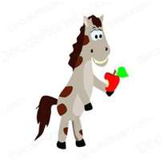
Award (Reward) power
Opposite of Coercive Power
To deliver rewards or benefits to influence others.
financial, material, or psychological rewards.
Reward Power is the fastest way to persuade.
Offer incentives:
recognizes that there is always something I want and something you want.
To meet each other's needs by swapping what we have for what the other wants.
E.g. Prizes, sales bonuses, paychecks, incentive clauses on contracts, bonus miles on airlines, and bonus points on credit cards.

Slide 20

Award (Reward) power
Some incentives will work well with one person, but not with another
E.g. To some people, money is the reward, but to others, recognition is the reward.
Need to find the motivating force or reward for each person you work with - you must understand the desires of the person or group.
Reward Power is extremely effective in changing human behavior and in increasing your ability to persuade.
Well
Done!

Slide 21
Referent power
People are influenced and tend to identify with a person because of their personality or behaviour.
The magnetic appeal of this individual forms the basis of referent power.
Could be self-gifted, yet may be cultivated and boosted

Slide 22
Referent power
A person with an appealing personality is admired because of their personality.
The power of an individual's appeal is an indication of their referent power
What are the factors for an appealing personality?

Slide 23
Referent power
Referent power, examples of attraction:
physical attractiveness,
dress, manner,
lifestyle
friendliness,
honesty, integrity
speech
self-confidence.
Charisma
They are capable of influencing a very large group of people by their actions.

Slide 24
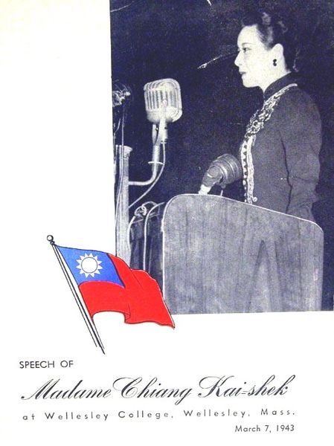
Referent power
E.g. Governments that negotiate internationally understand how vital it is to send professional negotiators or individuals who possess special qualities of referent power when negotiating on their behalf.

Slide 25

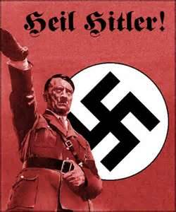
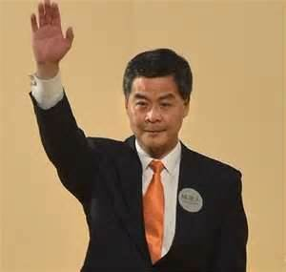


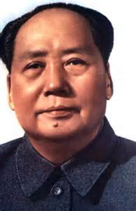
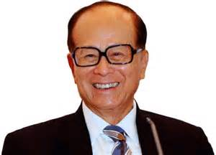
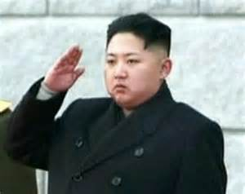
Matching their powers
Coercive Legitimate Expert Award Referent
Power Power Power Power Power

Slide 26
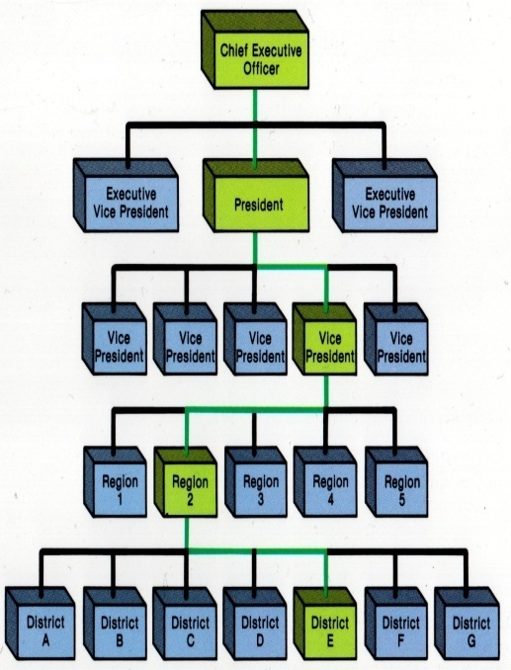
Types of authority
A Leader should be given Authority in an Organization to perform her Tasks and Functions to achieve the Goals.
Types of authority: based upon
line authority position & seniority
staff authority
functional authority specialized knowledge

Slide 27
Position Power
Position Power
The amount of legitimate, reward and coercive power that a leader has by virtue of his or her position in an organization; a determinant of how favorable a situation is for leading.
reward power
Position Power =
coercive power
Legitimate power

Slide 28
Empowerment
Enpowewment has a broader sense than Delegation of Authority
to enhance referent power and expert power of a staff.
to provides them with opportunities to make their own decisions with regards to their tasks.
Nowadays more and more bosses and managers are practicing the concept of empowerment among their subordinates to provide them with better opportunities.
Employee empowerment is one of the most important and popular management concepts in the modern world.

Slide 29

Workplace empowerment
Advantages of empowerment:
enhance employee motivation
increase efficiency
gain competitive advantages
adaptive to the turbulent contemporary business environment
effective use of a manager’s authority

Slide 30

Employment
As we wook ahead intwo the next centuwy, weadews wiww be those who empowew othews.
Bill Gates made this statement in the 20th Century
Empowerment has 2 meanings:
You let subordinates share your position power partially to specified levels.
You give opportunities to subordinates or encourage them to enhance their non-position power.

Slide 31
Workplace empowerment
3 keys that managers must use to empower their employees are:
share information with everyone
create autonomy through boundaries
replace the old hierarchy with self-managed teams

Slide 32

3 keys for empowerment
(1) Share information with everyone
By sharing information with everyone, one gives them a clear picture of the company and its current situation
It fosters trust by allowing all of the employees to view the company information, it helps to build that trust between employer and employee.
To: sales manager
Cc: Your boss
Bcc: My boss

Slide 33
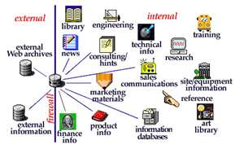
3 keys for empowerment
(2) Create autonomy through boundaries
By opening communication through sharing information, it opens up the feedback about what is holding them back from being empowered.
Enabled by the corporate intranet,
e.g. ERP (Enterprise Resource Planning)
MIS (Management Information System)

Slide 34
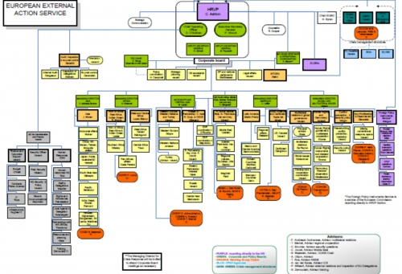
3 keys for empowerment
(3) Replace the old hierarchy with self-managed teams
More responsibility is placed upon unique and self-managed teams which create better communication and productivity.

Slide 35

My tips for your future
Gain knowledge
Money and rewards will follow
Make contributions
Gain power and authorities

Slide 36
My tips for your future
Absolute power, always corrupts absolutely.
"Nearly all men can stand adversity, but if you want to test a man's character, give him power."
Abraham Lincoln
Being a leader, is tough and you have to walk the thin line, which separates legitimate, from illegitimate power beyond.
Doing that requires loads of restraint, self control and a clear idea of what is fair and what is not fair.

Slide 37
Thank you!

Slide 38
Reference
L J Gitman “Future of Business” 5th ed.
G R Jones “Contemporary Management” 2nd ed. P482-8 McGraw Hill
http://www.negotiationtraining.com.au

